Slide 1

Dynamic Access Point Selection using Machine Learning
Institute of Industrial Automation
and Software Engineering
Final Presentation - Research Project
Student: John Benny
Supervisor: Sheng Ding
Examiner: Andrey Morozov

Slide 2
Motivation
A complex cyber-physical system such as a hybrid electric vehicle or an industrial production facility has more than thousands of sensors and associated signals.
In addition to this increasing complexity of signals, the CPS has several states as the system progresses.
For an effective and real time detection of anomalies in the system, it is imperative that a set of access points is determined for an error detector.
Owing to the dynamic behaviour of a system, the model must be trained to predict the relevant access points as the system progresses through different states.

Slide 3
Problem Definition
A variational or multi-state CPS requires a dynamic selection of access points for the efficient prediction of anomalies as the system varies or progresses adhering to a fixed feature budget.
As in the case study considered for this project, an electric motor and an SI engine enables a hybrid electric vehicle to pass through various ratios of electric powered and combustion engine powered states.
A dynamic model to predict the subset of access points is essential for the timely prediction of anomalies and subsequent remediation actions to ensure passenger safety.

Slide 4
Case Study
A P2 hybrid electric model in Simulink is chosen to synthesize signals similar to the situation.
A total of 3 drive cycles simulate various velocity profiles and the Simulink model subsequently generates the required electric and mechanical torque commands for the engine.
A total of 35 signals are chosen from the model to demonstrate the effectiveness of the proposed machine learning model.

Slide 5
Case Study
2 stuck-at faults are introduced into the system as anomalies.
Normal working is labelled as FaultNumber 0 in the dataset.
MotSpd sensor output to the hybrid controller is stuck at a value to signal a fault in the electric characteristics of the vehicle.
A fault in the Torque Command input to the SI engine powerplant is induced to induce an exertion on the electric powerplant to reach the intended velocity.

Slide 6
CMI and EVSI
After Literature research, two methods have been selected to be most promising to give an optimal solution to the problem.
Conditional Mutual Information is a parameter that measures the information that the variable under consideration holds about the response variable (Fault Present or Absent Signal).
Expected Value of Sample Information is a concept that is used to determine the cost that is associated with considering an additional signal for the decision making.

Slide 7
Why CMI?
CMI trains a policy and a predictor separately i.e. the selection of access points is using a policy model and a predictor is used to make subsequent predictions using the subset selected.
Dynamic Selection – The CMI method stands out due to its greedy policy model that predicts an optimal subset for each batch and updates the selection as it proceeds to the next.
This prediction of an optimal subset of access points is based on the greedy approach which is a concept of finding an optimum using locally available information.
This makes the greedy approach suitable for multi-state or variational system as it focuses on finding local optimum points for the objective function rather than considering the dataset as a whole. (Graphically explained next).

Slide 8
Advantage of Greedy CMI method – Dynamic Selection
DATASET
SWARM OPTIMIZATION
ACCESS POINTS
GREEDY CMI OPTIMIZATION
DATASET

Slide 9
Dynamic behaviour
This has the advantage that instead of considering the data from the system as one single entity, the model is trained to optimize the objective function with locally available information and treat the training dataset and thus the system as a variational entity.

Slide 10
Why EVSI? (Can CMI method be improved?)
CMI can be used to directly predict anomalies in scenarios where safety is not an immediate responsibility. For eg: a medical imaging system may not consider the cost to the patient in adding one more signal to its subset for several reasons. (Doctor can cross check if it is a false positive, computational time is not critical).
However, in safety sensitive CPS such as an automobile, or a manufacturing process, a false positive can cause disruptions on a more frequent scale and adding more signals to computation is becomes more time sensitive in decision making.
Thus, cost of adding a sensor needs to be weighed in terms of the impact of the sensor addition to predictive accuracy.
This introduces the concept of EVSI. (Expected value of Sample Information)

Slide 11
CMI-EVSI
1000+ Features
CMI
Select a subset of features based on maximimum mututal information Eg. 20
Predict optimum Subset
Eg. 10
System Fault
EVSI
Calculate the impact of selecting the feature on the system

Slide 12
CMI
1000+ Features
CMI
Select a subset of features based on maximimum mututal information Eg. 15
Predict optimum Subset
Eg. 10
System
EVSI
Calculate the impact of selecting the feature on the system

Slide 13
CMI
ITERATED BATCHWISE
1.Selection from one batch of data.
Locally available data ensures dynamic behaviour.
2.Predictor model to predict probabilities.
Predictor is used to make fault predictions on the data.
3.Calculate the loss in conditional mutual information.
The loss is backpropagated to learn to maximize mutual information.
4.Move to the next batch of data.
Move to next batch of data, suitable for a variational system behaviour.

Slide 14
EVSI
1000+ Features
CMI
Select a subset of features based on maximimum mututal information Eg. 15
Predict optimum Subset
Eg. 10
System
EVSI
Calculate the impact of selecting the feature on the system

Slide 15
Why is EVSI important to be considered?
In CMI as a standalone model, there is no mechanism to choose an efficient feature budget. The impact of the prediction on the system goes unmeasured.
1.How to identify the best feature budget? 2.How can we quantitatively measure the impact of the selected features on the system in terms of cost incurred due to ‘Cost of Remediation’ and ‘Plant Damage’? 3.How can we measure the increase/decrease in cost due to addition of an extra access point? i.e (Cost of sensor information acquisition – Cost of Remediation/Damage)

Slide 16

EVSI
${\text{E}}_{\text{(}\text{sensor} \text{subset}\text{)}}$ = Pr(signal)∗min(R ∗ Pr($\overline{fault}$|signal),P ∗ Pr(fault|signal)) + Pr($\overline{signal}$)∗min (R ∗ Pr($\overline{fault}$| $\overline{signal}$),P∗Pr(fault| $\overline{signal}$))
Sensor Subset
$$signal$$
𝑠𝑖𝑔𝑛𝑎𝑙
Fix
No Fix
$$\overline{signal}$$
(𝑠𝑖𝑔𝑛𝑎𝑙) ̅
$$fault$$
𝑓𝑎𝑢𝑙𝑡
$$\overline{fault}$$
(𝑓𝑎𝑢𝑙𝑡) ̅
$$fault$$
𝑓𝑎𝑢𝑙𝑡
$$\overline{fault}$$
(𝑓𝑎𝑢𝑙𝑡) ̅
Fix
$$fault$$
𝑓𝑎𝑢𝑙𝑡
$$\overline{fault}$$
(𝑓𝑎𝑢𝑙𝑡) ̅
No Fix
$$fault$$
𝑓𝑎𝑢𝑙𝑡
$$\overline{fault}$$
(𝑓𝑎𝑢𝑙𝑡) ̅
R = Cost of Remediation, P = Plant Damage

Slide 17
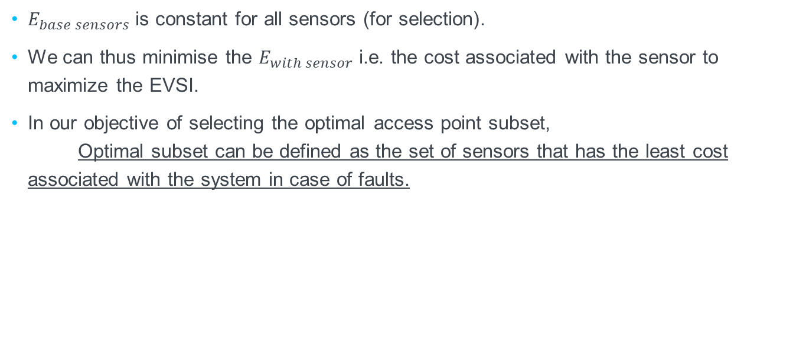
EVSI
$${EVSI}_{sensor}=E_{base sensors}−E_{with sensor}$$
$E_{base sensors}$ is constant for all sensors (for selection).
We can thus minimise the $E_{with sensor}$ i.e. the cost associated with the sensor to maximize the EVSI.
In our objective of selecting the optimal access point subset, Optimal subset can be defined as the set of sensors that has the least cost associated with the system in case of faults.

Slide 18
Optimum Selection
1000+ Features
CMI
Select optimal subsets based on maximum mutual information
Predict optimum Subset
Choose the subset with the minimum cost to system
System
EVSI
Calculate the impact of selecting the subset on the system

Slide 19
Optimum Selection
Dynamic CMI Maximization
Impact on System Cost in terms of Remediation [EVSI]
Dynamic Access Point Subset
=

Slide 21
Institut of Industrial Automation
and Software Engineering

